Slide 1




HACK THE GAP 2026
HACK THE GAP 2026
TITLE PAGE
• Team Name: CODERS
• Problem Statement Title: SMART MECHANISM TO DETECT LEAKAGE OF GAS IN
UNDERGROUND METALLIC PIPELINES
• Category: HARDWARE
• Theme: IOT PROJECT
HACK THE GAP 2026

Slide 2
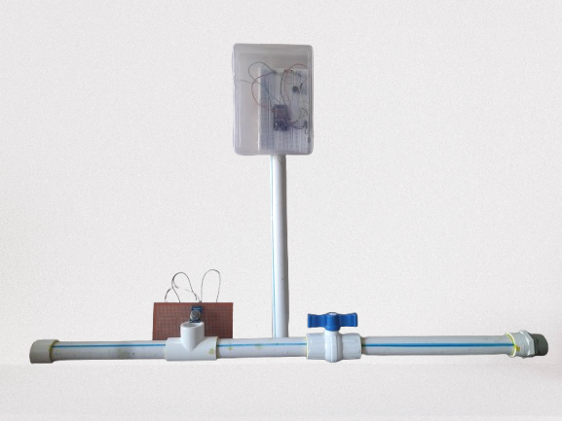
Smart Mechanism To Detect Leakage Of Gas In Underground Metallic Pipelines
Proposed Solution (Describe Idea / Solution / Prototype)
Gas leaking from underground pipelines is dangerous because methane can cause fires, explosions, and health problems. Old methods to find leaks are slow and costly.
Using IoT technology, we can create a smart and low-cost gas leak detection system. In this project, an ESP32 reads gas levels from an
MQ4 sensor. If leakage is detected, it turns on a buzzer and LED, sends the data to Thingspeak cloud, and a MATLAB script sends email alerts. A dashboard shows live gas readings for easy remote monitoring.
This system is simple, fast, energy-efficient, and useful for homes, industries, and long pipeline networks.
HACK THE GAP 2026

Slide 3
Project Key Features
Real-Time Gas Monitoring
ESP32-Based Smart Control Unit
Instant Local Alerts
Automatic Email Notifications
Scalable & Low-Cost Architecture
Energy-Efficient Operation
Easy Integration & Expansion
HACK THE GAP 2026

Slide 4
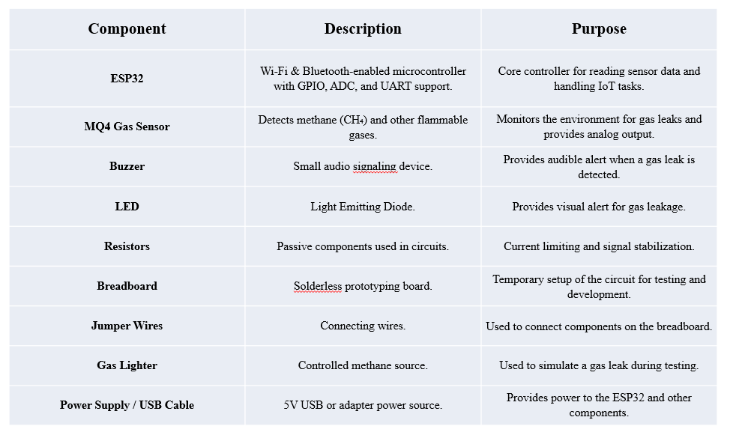
Hardware Components
HACK THE GAP 2026

Slide 5
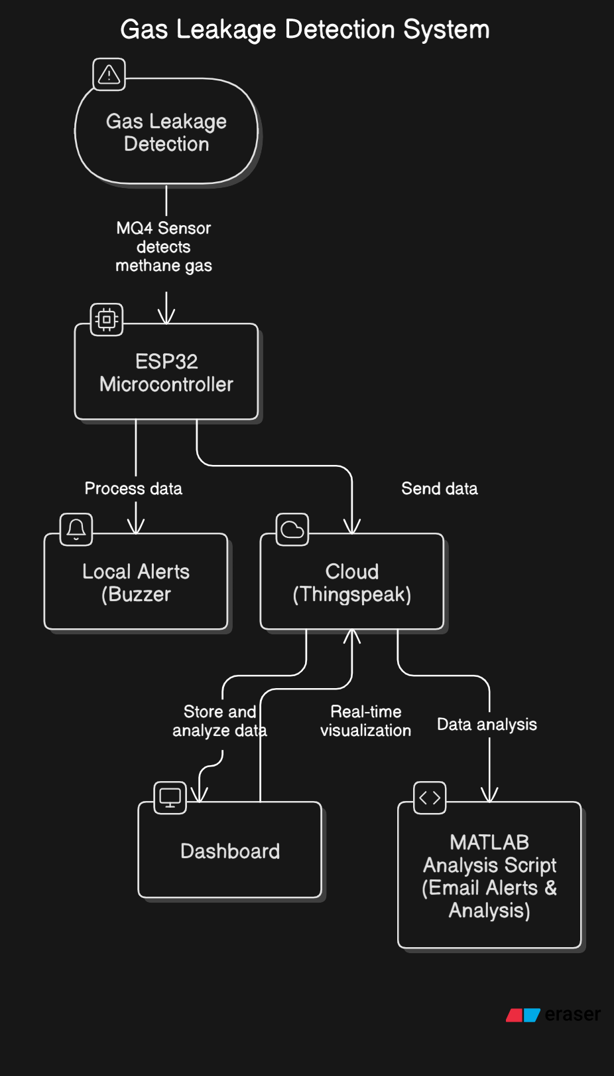
System Flow Chart
1. MQ4 Gas Sensor detects methane gas leakage.
2. ESP32 Microcontroller receives and processes the sensor data
.
3. If gas concentration increases, a local alert (buzzer) is activated.
4. The ESP32 sends data to the ThingSpeak cloud platform.
5. Gas data is stored and analyzed in the cloud.
6. A dashboard shows real-time gas level visualization.
7. MATLAB analysis scripts perform data analysis and send email alerts.
HACK THE GAP 2026

Slide 6
Conclusion/Future Work
GSM Module – Remote alerts without Wi-Fi.
Pressure Sensors – Detect leaks based on pressure change.
AI/ML – Predictive maintenance..
Sensor Fusion & Calibration – Improve accuracy.
Solar Power / LoRa / Edge AI
Emergency Integration – Auto alert to authorities.
HACK THE GAP 2026

Slide 7
Thank You!
HACK THE GAP 2026

